Slide 1
A Machine Learning Approach to Predicting Employment Practice Liability Claims
Identifying Companies Most Likely to Get Sued
Christopher Cirelli
11/29/2017

Slide 2
TABLE OF CONTENTS
Phase I
Business Problem
Data Preparation
Analytics Based Table
Data Analysis
Key Takeaways
Phase II
Notes:
Statistics:
1. http://www.lockton.com/whitepapers/Boeck_Employment_Practices_Liability_Claim_Trends_April_2017-lo_res.pdf
2. https://www.hiscox.com/documents/The-2015-Hiscox-Guide-to-Employee-Lawsuits-Employee-charge-trends-across-the-United-States.pdf

Slide 3
SECTION I: PROBLEM
Employment Practices Liability
Is an area of United States law that deals with wrongful termination, sexual harassment, discrimination, invasion of privacy, false imprisonment, breach of contract, emotional distress, and wage and hour law violations. Employment Practices Liability is part of professional liability.
Employment Practice Insurance:
Employment practices liability (EPL) insurance is a type of coverage that protects businesses from the financial consequences associated with a variety of employment-related lawsuits.
Statistics:
$296m was the total cost of the top 10 class action settlements in 2015 totaled.
$125k was the median cost to settle a claim in 2016
11% was the change of any one company incurring an EPLI lawsuit in 2016.
Business Problem:
Using machine learning algorithms, attempt to predict those companies most likely to incur an Employment Practice Liability Claim.
Notes:
Statistics:
1. http://www.lockton.com/whitepapers/Boeck_Employment_Practices_Liability_Claim_Trends_April_2017-lo_res.pdf
2. https://www.hiscox.com/documents/The-2015-Hiscox-Guide-to-Employee-Lawsuits-Employee-charge-trends-across-the-United-States.pdf

Slide 4
SECTION I: DATA SOURCES
Sources:
Salesforce (policy data)
Loss Report (claims data)
Data Source | Rows | Columns
Policy Data set | 4,301 | 22
Claims Data set | 14,652 | 20
Salesforce
Loss Report
Data-type | Count
Categorical | 10
Numerical | 5
Text / ID | 6
Date-Time | 1
Grand Total | 22
Data-type | Count
Text / ID | 8
Date-Time | 6
Categorical | 4
Numerical | 2
Grand Total | 20
Notes:
The data sources that I am using for the study are two fold.
The first is policy information obtain from Salesforce. The time period ranges from 2014 to present and comprises information for the client and policy. Examples include the date of purchase, location, type of coverage, broker that distributed the product, revenues, employee count, and premium.
The second is a claims data set that includes claims dating back to 2010. Much of the information comprises dates, loss description, loss type, policy type, etc.

Slide 5
SECTION II: DATA CLEANING
Steps – Both Data Tables:
Make uniform column datatypes
Limit claims data to 2014-2017
Limit data to EPLI coverage & claims
Group claims by policy number
Replace missing industry name using SIC
Convert policy # in claims and policy datasets to
‘str’
Merge files.
Eliminate obvious columns w/ no predictive value (Production Region, Pol-number, Sub-name, DUNS number, City, Placing broker, Profit Center, Covg section verifier, Client Description)
 | 0
Policy Effective Date | 2014-01-01 00:00:00
Assigned Production Region | Confidential
Policy Number - Current | Confidential
Submission Name | Confidential
DUNS Number | 77761062
Billing State/Province | OH
Billing City | Youngstown
Placing Broker Ultimate Parent Producer | Confidential
Placing Broker | Confidential
Product Profit Center | Commercial Not for Profit - 31500
Coverage Section Verifier | 1
Client Description | Confidential
Industry | Consulting
SIC Code | 8732
PriorYearRevenue | $13,422,335
Annual Revenue Currency | USD
Annual Revenue | $3,290,706
PriorYearEmployees | 224
Employees | 224
100 Percent Policy Booked Premium Currency | USD
100 Percent Policy Booked Premium | $6,334
Ownership | Private
Salesforce Pol Number | SISIFNL20024814
Claim Pol Number | SISIFNL20024814
Claim Count | 1
Notes:
Objective:
My initial objective was to merge the two data sets such that I had a binary target of 1/0 indicating for a given policy whether or not it had incurred a claim.
This required a lot of work to clean the data for merging.
Make uniform column datatypes – Each column included multiple datatypes. For example, half the policy numbers were in text, others numerical. This had to be done before the data frames could be merged as the policy number was the unique ID that I was using to merge the frames.
Our policy record only went back to 2014, so I needed to limit the claims data to 2014.
Each policy can contain multiple coverage sections, so I needed to identify those that had EPLI, which is not always clear for excess policies. Nor does the claims data clearly delineate if a claim was for an EPLI violation.
The claims data was structured by claim, which mean that I had anywhere from 0 to 20 claims per policy. Therefore, I needed to group the claims by policy number and then convert the number of claims to 1/0.
Merge files
Lastly, eliminate columns with what I believe to have little or no predictive value or to be redundant.

Slide 6
SECTION III: Analytics Based Table (ABT)
Em | State | Broker | Industry | SIC Code | Revenues | Replace Rev(0) w-Median | Change Revenues | Employees | Replace E-Count(0) w-Median | Change Employees | Target (Claim 1/0)
0 | OH | A | Consulting | 8732 | $3,290,706 | $3,290,706 | -$10,131,629 | 224 | 224 | - | 1
1 | TX | B | Finance | 7322 | $15,097,958 | $15,097,958 | -$2,042 | 200 | 200 | - | 0
2 | VA | C | Not For Profit | 8641 | $50,797,720 | $50,797,720 | $50,640,188 | 2,200 | 2,200 | - | 1
3 | CA | D | Machinery | 3541 | $234,068,645 | $234,068,645 | $234,068,645 | 1,400 | 1,400 | 400 | 0
4 | GA | E | Telecommunications | 4833 | $812,465,000 | $812,465,000 | $466,167,000 | 3,996 | 3,996 | 1,748 | 0
5 | FL | F | Insurance | 6411 | $16,558,563 | $16,558,563 | $7,858,563 | 100 | 100 | - | 0
6 | GA | G | Retail | 5047 | $79,811,630 | $79,811,630 | $50,511,630 | 210 | 210 | - | 1
348 | PA | H | Mining | 1099 | $1,388,030,494 | $1,388,030,494 | $1,245,230,494 | 1,001 | 1,001 | - | 1
Features
State
Broker
Industry
SIC
Revenue
Revenue ^
Features
Employee Count
Employee Count ^
Target
Claim 1 or 0
Notes:
This is the Analytics based table that I wound up with.
From left to right we have…
State: Because employment laws vary widely by state, the likelihood of a company incurring an EPLI violation varies by state.
Broker: Some brokers specialize in hard to place business.
Industry: Self explanatory.
SIC Code: Includes a lower level of granularity versus the Industry column, which uses the first 2 bits of the SIC Code.
Revenues: Indicative of the size of the corporation.
Employees: Indicative of the number of potential claimants.
Rev Median There were about 100 records in both the Revenue & EE column that had a 0 value. So I replaced them with the median value.
Target: Did the company incur a claim or not in the time period of the study.

Slide 7
SECTION IV: DATA ANALYSIS
Tables:
Scatter Matrix
Incidence of claims relative to revenues & employee count.
Correlation of revenues to employee count.
Incidence of Claims by State
Incidence of Claims by Industry
Incidence of claims by change in revenues / employee count
Correlation between features
Notes:
Make uniform column datatypes – Each column included multiple datatypes. For example, half the policy numbers were in text, others numerical. This had to be done before the data frames could be merged as the policy number was the unique ID that I was using to merge the frames.
Our policy record only went back to 2014, so I needed to limit the claims data to 2014.
Each policy can contain multiple coverage sections, so I needed to identify those that had EPLI, which is not always clear for excess policies. Nor does the claims data clearly delineate if a claim was for an EPLI violation.

Slide 8
SECTION IV: MEASURES OF CENTRAL TENDENCY
 | SIC Code | Revenues | Replace Rev(0) w-Median | Change Revenues | Employees | Replace E-Count(0) w-Median | Change Employees | Claim Count
count | 3,277 | 3,277 | 3,277 | 3,277 | 3,277 | 3,277 | 3,277 | 3,277
mean | 6841 | $279,974,788 | $281,074,165 | 136,638,270 | 1,204 | 1,209 | 169 | 19%
std | 2101 | $1,594,176,087 | $1,593,986,745 | 1,194,871,078 | 6,304 | 6,303 | 2,128 | 39%
min | 174 | $0 | $223 | (4,291,621,777) | - | 1 | (3,000) | 0
25% | 5813 | $746,000 | $2,349,913 | - | 7 | 15 | - | 0
50% | 7381 | $12,130,156 | $12,130,156 | 1,649,503 | 68 | 68 | - | 0
75% | 8361 | $77,517,687 | $77,517,687 | 34,032,820 | 400 | 400 | - | 0
max | 9999 | $56,800,000,000 | $56,800,000,000 | 56,730,100,000 | 127,368 | 127,368 | 50,882 | 1
ABT
Number of Features => 8
Total number of records => 3277
Total number of claims => 617
Policies with Claims => 18.9%
Observations:
Records => Small
Revenue => High Std / Errors
Employees => High Std / Little ^
Overall => Large outliers
Notes:
Here is the measures of central tendency for the Analytics Based Table.
Oberservations:
# Records Pretty small for a machine learning problem. We may run into issues in which certain features have very few counts of policies and claims.
Revenue & Employees Decent spread and number of outlier for each numerical feature.
-

Slide 9
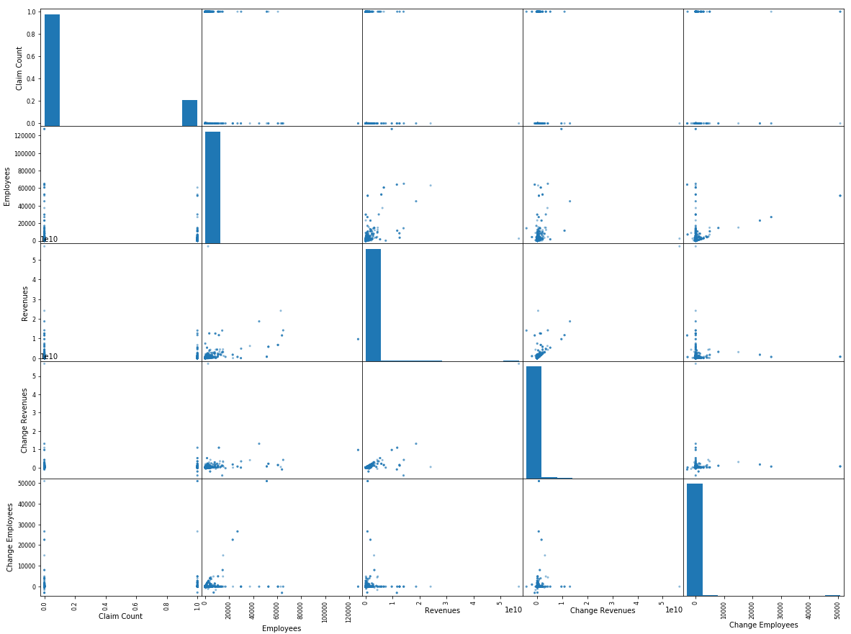
SECTION IV: SCATTER MATRIX
Notes:
For the most part I didn’t find this scatter matrix all that helpful. Really the only linear relationship that seems to resonate is the relationship between revenues and employee count.
I had more success with the relationship using the categorical values and categorizing some of the numeric values to demonstrate relationships w/ the data.
Question: Should we have normalized the data or used a logarithmic scale before creating the scatter matrix?

Slide 10
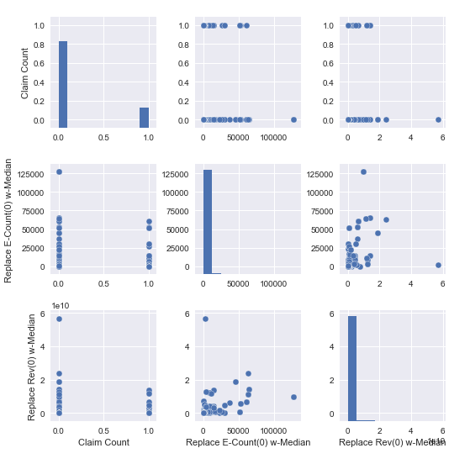
SECTION IV: SCATTER MATRIX (SEABORN)

Slide 11
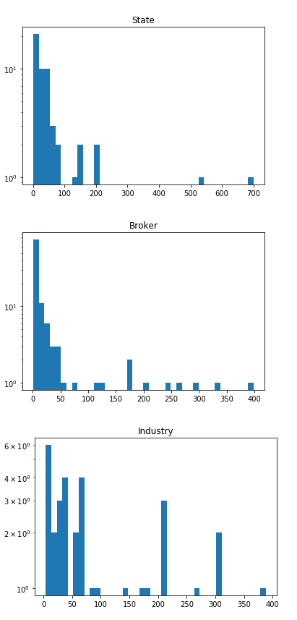
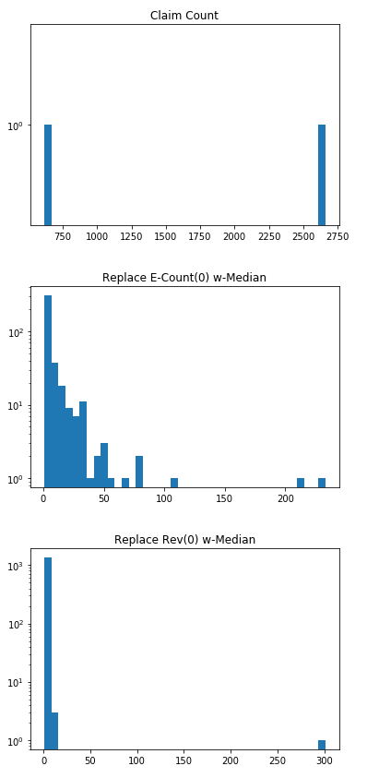
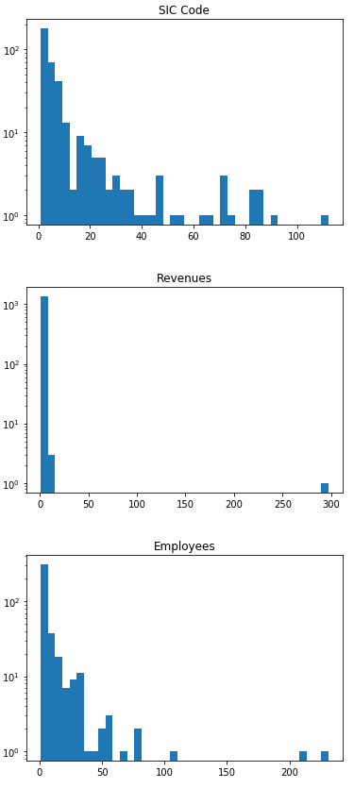
SECTION IV: HISTORGRAMS

Slide 12
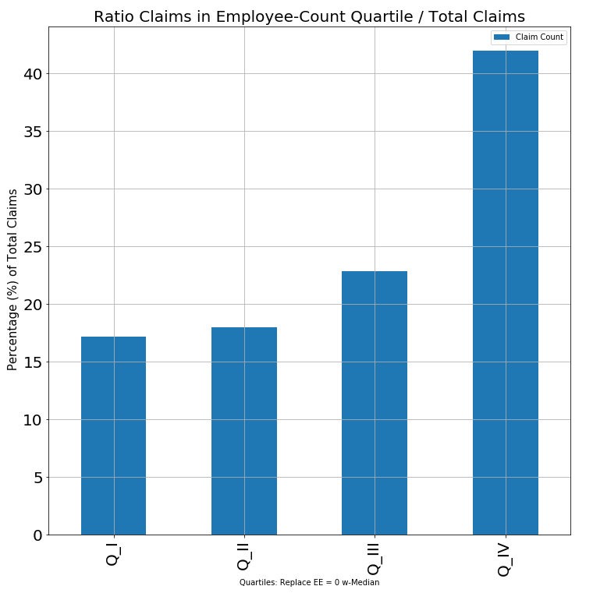
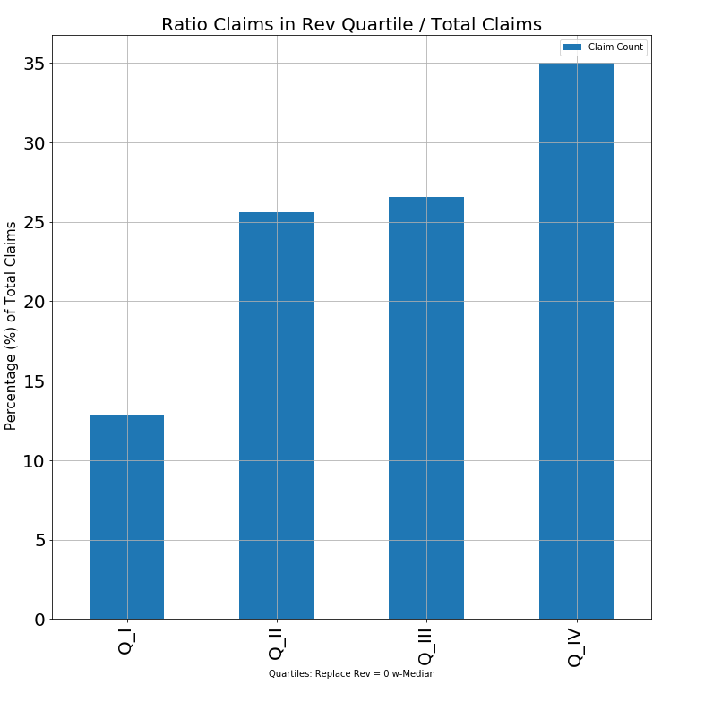
SECTION IV: CLAIMS VS EMPLOYEE / REV.
Notes:
Here I graphed the relationship of the % of claims based on 4 quartiles of the features Employee Count & Revenues. So I created the quartiles and then grouped the data by those quartiles and measured the number of claims received by that group over the total number of companies within that group.
The results I got were pretty straight forward and someone logical. The larger the company and the larger the employee base, the higher the % of companies that incurred at least 1 claim.
You could probably turn this into a data point in and of itself such that there is a weight or probability given to each employee such that we can predict the above % for a given company w/ x number of employees (hence the linear relationship).
Revenues
QI = < or = $1,400,000
QII = 1,400,001 to $12,130,156
QIII = 12,130,157 to $77,517,687
QIV = > or = $77,517,688

Slide 13
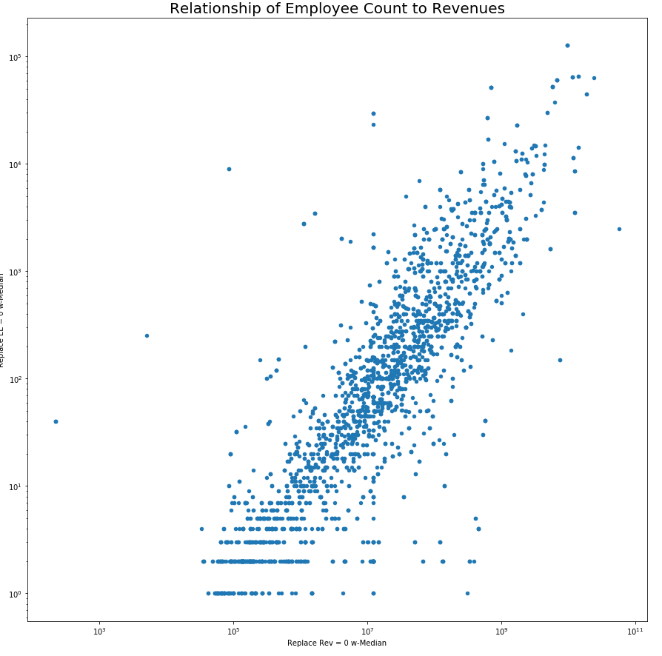
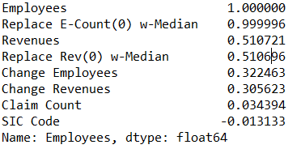
SECTION IV: CORRELATION REV + EMPL.
Takeaway:
Revenues and Employee count appear to be highly correlated.
Consider removing one of the features.
Notes:
Given the similarity in the claims incidence for both revenues and employee count, I wanted to see how they stacked up on a scatter plot.
Here we can see that there is a linear relationship between the two, i.e. as revenues increase, so too does employee count.
Seems to make sense.

Slide 14
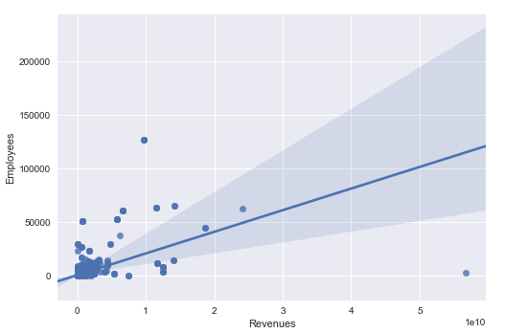
SECTION IV: REGRESSION PLOT

Slide 15
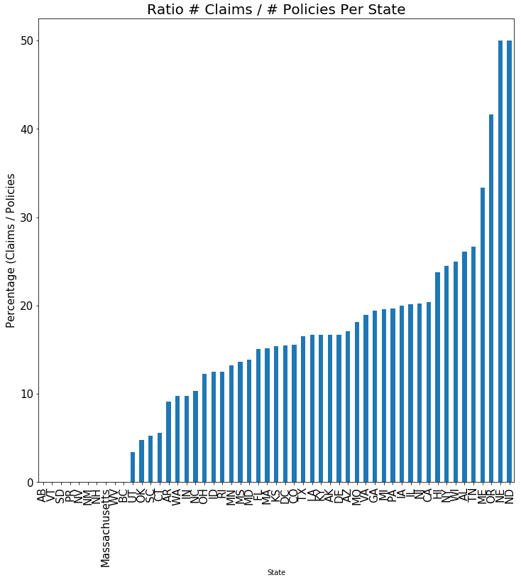
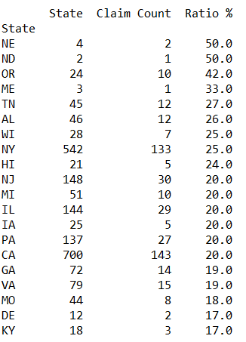
SECTION IV: % Claims By State
Takeaway:
There is likely a higher correlation amongst states with a high policy count and high percentage of total claims.
A low policy count for any one state is a limitation of this data set in our ability to generalize to unknown examples.
Notes:
This is a graph o four first categorical feature, ‘State’.
The bars represent the % of companies sued of the total issued policies for that state. So in the case of Nebraska, we have 4 policies issue and 2 were sued.
A good example is the difference between Wyoming and NY. We would probably have more confidence in our ability to generalize with new companies in NY vs WI.

Slide 16
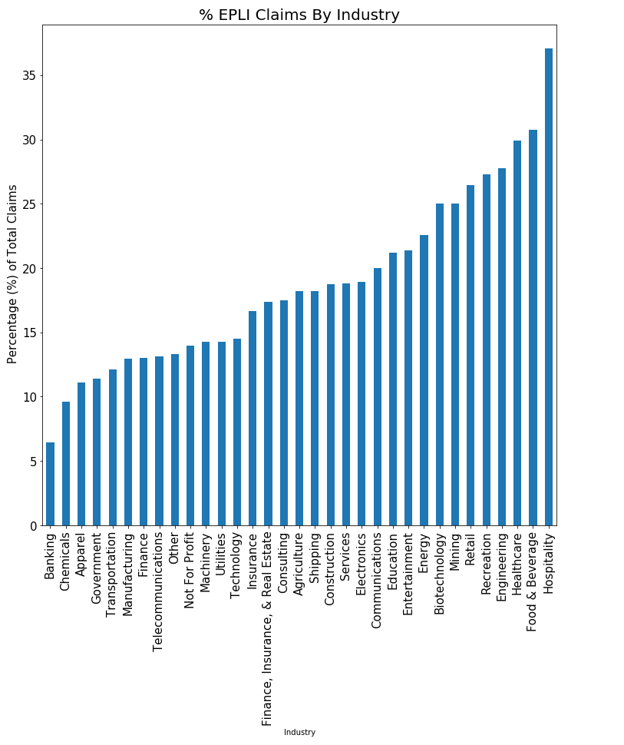
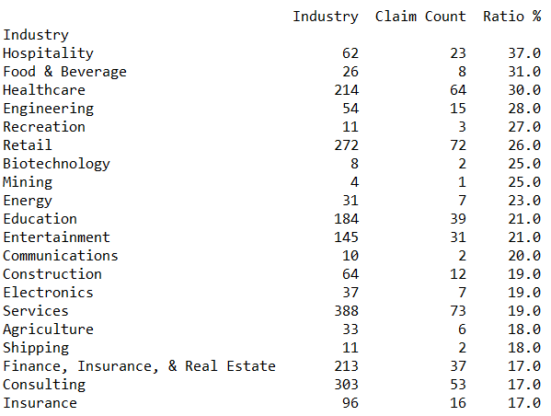
SECTION IV: % Claims By Industry
Takeaway:
There is likely a higher correlation amongst states with a high policy count and high percentage of total claims.
A low policy count for any one state is a limitation of this data set in our ability to generalize to unknown examples.
Notes:
I conducted the same exercise for EPLI claims by industry. Here are the results.

Slide 17
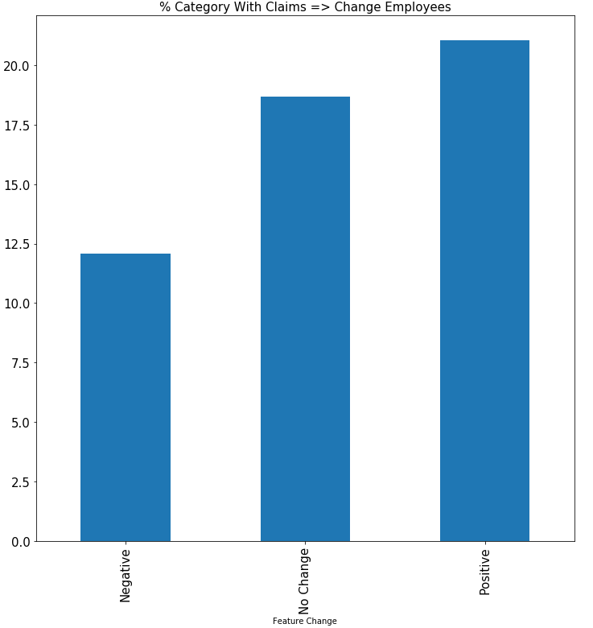
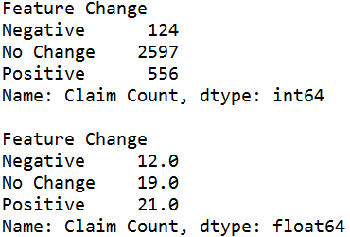
SECTION IV: ^ Empl. Count & Claim Incidence
% Claims per grouping
Takeaway:
Only 21% of companies had a change in their employee count. 4% had decreases and 17% increases with 79% showing no change.
Companies with a positive increase in their employee base were actually more likely to get sued than those with a decrease.
This feature may be limited in the number of samples than showed a ^ in their employee base.
Notes:
The purpose of this graph was to see if there was a relationship between the incidence of claim for those companies with increase/decreasing employee counts.
The underlying rational being that when companies are downsizing, i.e. firing employees, they are more likely to get sued by the employee / employee(s) whose employment relationship was severed.
Unfortunately, what I found when looking at the data was that the majority of companies did not have a significant change in employee count y/y.
In addition, it appears that companies who were increasing their employee count actually got sued more often then those decreasing.

Slide 18
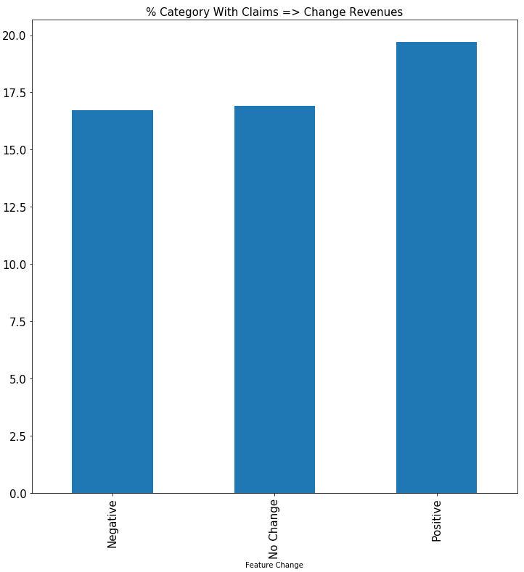
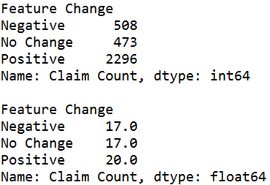
SECTION IV: ^ Revenues & Claim Incidence
% Claims per grouping
Takeaway:
86% showed a change in revenues, 16% negative and 70% positive.
That being said, there was little difference in the incidence of claims for those companies that had negative no change, with a slight difference, 3% in those that showed an increase.
There may be a potential to look at combining the change in revenue and employee variables to see if there are any further relationships that can be discovered

Slide 19
SECTION V: KEY TAKEAWAYS
Key Takeaways:
Data preparation for machine learning takes a long time.
There appears to be a linear relationship between revenues/employee count and the incidence of EPL claims.
There appears to be a clear relationship between the industry and state in which a company resides and the incidence of claims.
Little if any relationship was seen between the increase/decrease in revenues/employee count and the incidence of claims.
This dataset may be limited by its size.

Slide 20
MACHINE LEARNING ALGORIGM SELECTION
Objective:
A Machine Learning approach to predicting EPL Claims.
Characteristics of Problem & Data
Problem: Classification
Data: More categorical than numerical
Relationship: Possibly non-linear
Models:
Decision Tree
Random Forest
Nearest Neighbor
Naïve Bayes
Strengths:
White-box
Classifiers
Simplistic
Notes:
Introduction
- My name is Chris Cirelli.
I presented a few weeks ago on a proposal to use Machine Learning techniques to predict Employment Practice Liability Claims.
Data set comprised of policies and claims.
8 features, mostly categorical data.
Identified relationships between subcategories of these features and the incidence of claims, which gave us confidence that we may be able to predict those companies most likely to incur a claim.
How algorithms were chosen?
Understanding the ‘type’ of problem for which we are trying to solve; one of ‘Classification’ or ‘Grouping’. Therefore, algorithms that use a logic based on association would probably fit best.
Knowing that we had a small data set and that it is comprise of largely categorical data. Therefore, algorithms that are good for large data sets would likely not be appropriate.
Considering the number of categorical features to numerical and the type of problem, the solutions was supposed to likely not be linear.
Why were these algorithms chosen?
How will you seek to measure your classifiers?

Slide 21
TEST / TRAIN APPROACH
Approach:
Train/test model w/ no modifications
Inspect results
Adjust parameters
Train/test
Opinion
Measurement:
Precision: TP / (TP + TN) How often the model correct when it predicts ‘True’
Accuracy: (TP+TN) / N Percentage of sample total we predicted correctly
Recall: TP / (TP+FN) Percentage of total true values our model predicted correctly
F1: Mean P , R Mean score of Precision and Recall
Most appropriate for our study = ‘Recall’
Note: Decision Tree skipped parameter adjustment and went directly to Ensemble learning
Notes:
The approach to training and testing the classifiers is straight forward.
For each classifier we will train and test the model without any modifications
We will then inspect the results
Adjust parameters
Re-train and test
Form and opinion of the results.
In terms of how best to measure the success of our models, the most appropriate measures appears to be ‘Recall’. In light of…
Our stated goal
Severe financial consequences for a single EPL claim.
Recall appears to be the most approach measurement for our study.

Slide 22
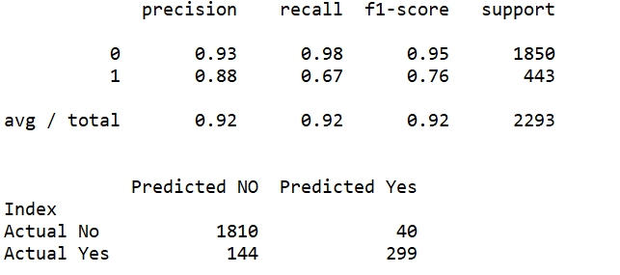
DECISION TREE
Parameters
2293 Test Set
Tree Single, no modifications
TRAINING-SET
Results
0.67 Recall Score for ‘1’
Observations
Possibly under fitting
Notes:
To the right you will see the training results of our single decision tree without modification.
This training set consisted of about 70% of our data set.
Results:
It generated a Recall score of 0.67, which is not great for the test set.
Observations:
- The tree could be under-fitting our test set.

Slide 23
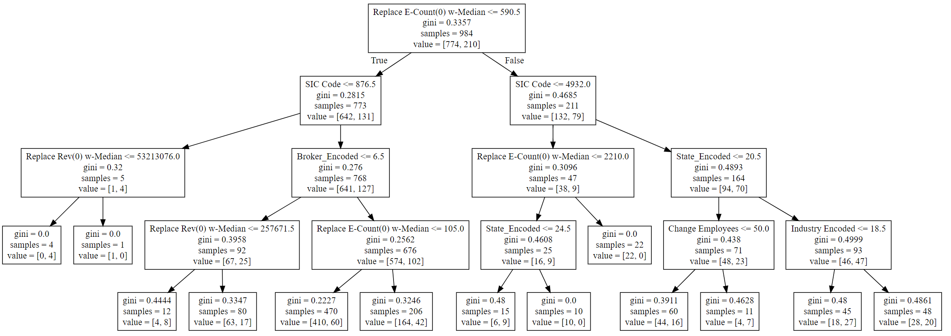
DECISION TREE: ‘Visualization’
Max-Depth => 6
Observations :
Model feature selection consistent with results from dataset inspection.
Highest contributors: Employee Count, SIC Code, Revenue and State.

Slide 24
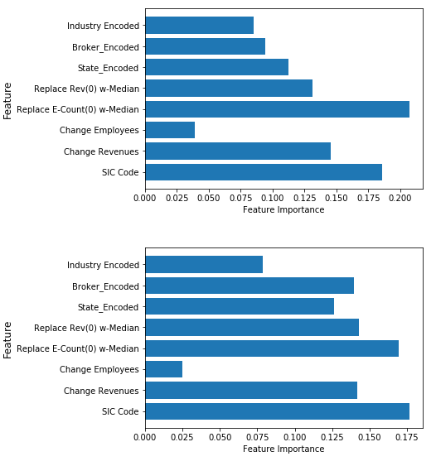
DECISION TREE: ‘Feature Importance’
No Max-Depth
Training Set
Observations :
With no maximum depth, the features ‘Employee Count’ & ‘SIC Code’ appears to cause the tree to over-fit both the training and test sets.
Key takeaways:
Look to see if the more predictive features an be grouped in order to obtain a more generalizable model.
Test Set
Notes:
Here is another view of feature importance graphed by feature on the y-axis and the gini score on the x-axis.
Sames results as with the visualization of our decision tree.
Employee count, SIC Code, Change Revenues.

Slide 25
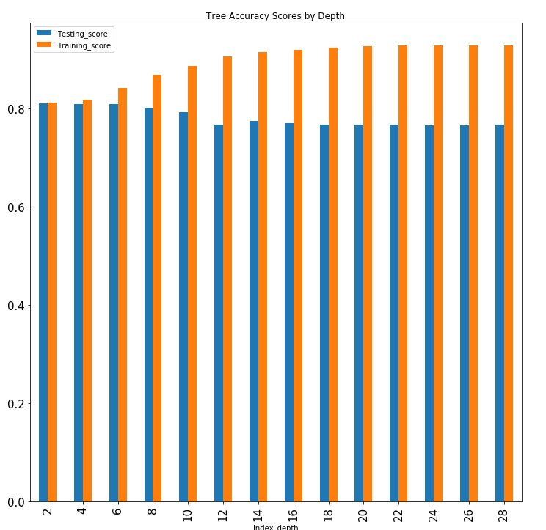
DECISION TREE: ‘Depth’
Observations:
At a max-depth of 6 the model begins to better fit the training set yet under-fit the test set.
Depth does not seem sufficient data to make a prediction
Notes:
Simply because I was concern about the potentially under-fitting of the model with the training set for an un pruned tree, I wanted to see the potential effects of the depth on accuracy.
Here we can see that as the tree grows in depth, the training score increases yet the test score falls leveling off around 10 – 28. Odd.

Slide 26
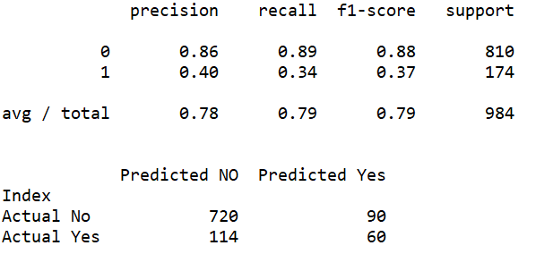
DECISION TREE: Conclusion
Results
Single tree classifier with no modes does a poor job of generalizing to unknown sample set.
0.34 Recall Score
TEST-SET
Next Steps
Ensemble learning
Hyper-parameter modification

Slide 27
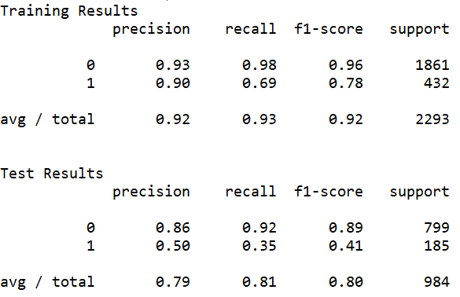
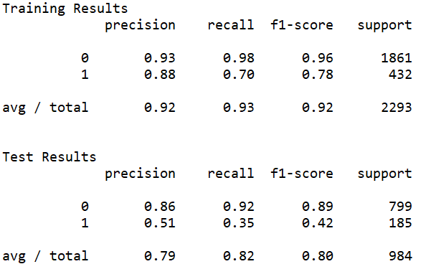
Ensemble Learning
Approach:
Feature selection:
No pruning,
Max_samples = 2,200
n_estimators = 500
Bootstrap = True
Test Results:
Recall: +0.01
Prevision: +0.1
F1 Score: + 0.05
Conclusion:
Unclear.
Potentially due to lack of hyper parameter tuning.
Bagging
Random Tree
Notes:
Here I ran the same

Slide 28
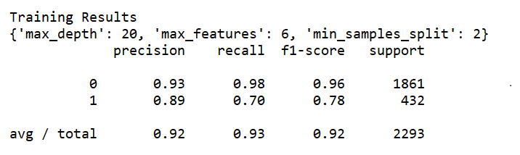
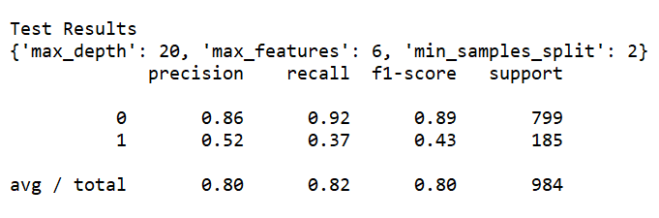
GridSearchCV Results
Define GridSearchCV:
Parameters Tested:
Max_depth,
Min_samples_split
Min_samples_leaf
Min_weight_fraction_leaf
Max_features
Max_leaf_nodes
Best fit:
n_estimator = 400
Max_depth = 20
Min_samples_split 2-3
Max_features = 6
*Other factors detracted from model prediction power.
Test Results:
Recall +0.02
Prevision +0.01
F1-score +0.01
Notes:
Key Takeaways?
Changes in scores insignificant to state that these techniques are improving the model.
Odd to see that the GridSearch chose a max_depth of 20 when our own investigated showed that after 6-8 the model started to underfit.

Slide 29
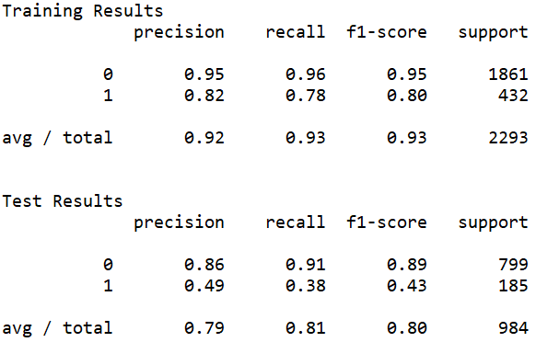
AdaBoostClassifier
Define AdaBoostClassifer:
Parameters Tested:
No change
Best fit:
No change
Conclusions:
No material benefit obtained from parameter optimization.
Model has issues fitting to train set and generalizing to test set.
Notes:
Explain the AdaBoostClassifier Technique:
Model adds more weight to the incorrect predictions of the model to each successive iteration.

Slide 30
DECISION TREE - FINAL RESULTS
Observations:
Model appears to under-fit as opposed to over-fit the train-set causing issues with generalizing to the test-set.
The ‘Bagging’ and ‘Random Forest’ approach to creating multiple trees generated minimal improvement to the Recall Score.
Hyper-parameter optimization using the GridSearchCV approach yielded less than desirable results in terms of the predictability of the model.
Conclusion:
Additional models should be tried before drawing a conclusion as to whether the feature being used allow for the prediction of EPL claims.
Notes:
Recall = TP / (TP + FP)
How many times we are correct when we predict the account has a claim.

Slide 31
NEAREST NEIGHBOR (NN)
Objective:
Using the Nearest Neighbor algorithm, attempt to predict / classify those companies most likely to incur an EPL claim.
Approach:
Prepare data – OneHotEncoding
Prepare a simple NN classifier and obtain predictions.
Modify hyper-parameters to enhance predictability.
Expectation:
That the classifier will yield similar results to that of the Decision Tree.

Slide 32
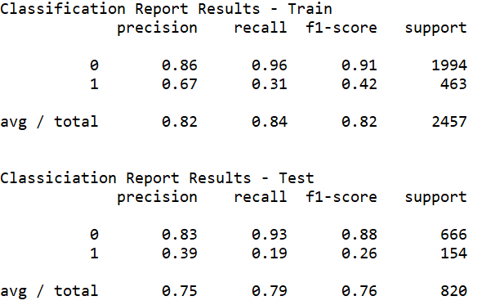
NN – No Modifications
Objective:
Determine the predictability of a simple nearest neighbor classifier.
Performance:
Performance relative to the Decision Tree is poor.
Enhancement:
Attempt to enhance the classifier by tuning the hyper-paramemters.

Slide 33
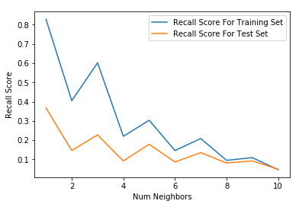
NN – MODIFICATION
Objective:
Enhance classifier modifying hyper-parameters.
Modifications:
Weights = Nearest
n_Neighbors = 3
Leaf_size = 40
Algorithm = kd_tree
Results:
Slightly better results were obtained with the modifications.
+0.04 improvement in Recall score vs Decision Tree.
Notes:
*** Based on the trend in the recall score vs # nearest neighbors, it may be the case that there are more similarities between claims and non-claims companies that can be ascertained from the features being used in this study.

Slide 34
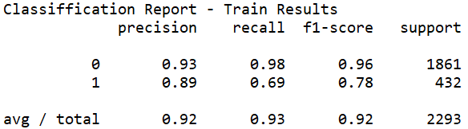
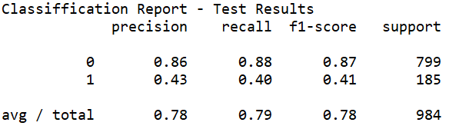
NEAREST NEIGHBOR- FINAL RESULTS
Observations:
The Nearest Neighbor classifier post hyper-parameter modifications performed slightly better than the Decision Tree classifier in terms of its Recall Score.
Conclusion:
Inconclusive
Notes:
Key Takwaway “Maybe Companies With Claims” look very similar to those that don’t get sued. At minimum with the features that we are using.

Slide 35
Naïve Bayes (NB)
Objective:
Probabilistic classifier based on the Naïve Bayes Theorem.
Simplistic model based on the product of feature level conditional and feature probabilities.
Assumes feature probability independence.
Approach:
Obtain base line results
Feature elimination as an attempt to enhance results.
Expectation:
Optimistic that the model will yield at minimum comparable results to the former two classifiers.

Slide 36
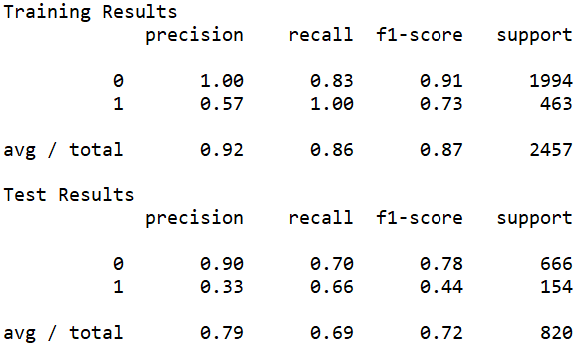
Naïve Bayes
Results
+0.26 > than NN
+0.26 > Decision Tree
Observations
Initial results were promising.
With no modifications the recall score for the Training set was 100 for accounts w/ claims and 66 for the Test set.
Next Steps:
Feature elimination
Recall Score – No Modifications

Slide 37
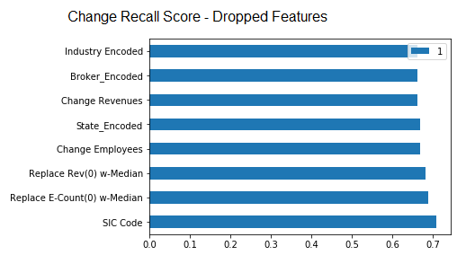
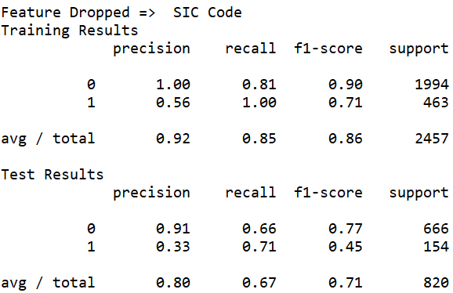
Naïve Bayes - Conclusion
Results:
Largest increases in the Recall score were observed when dropping the SIC Code, Employee Count and Revenue features.
+ 0.04 improvement.
Key Takeaway
Highly correlated features detract from model Accuracy

Slide 38
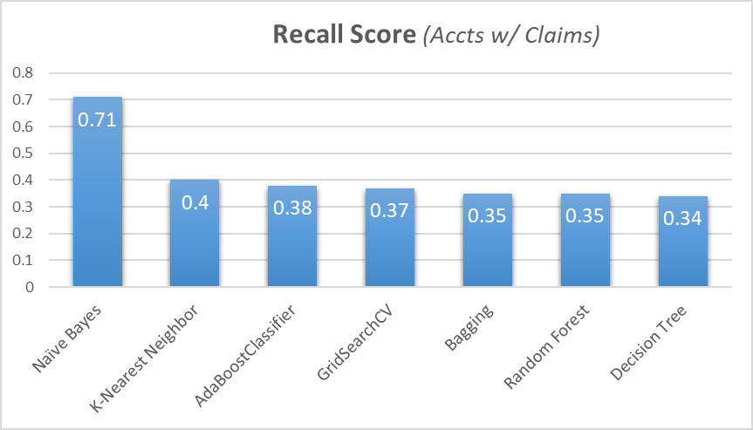
STUDY CONCLUSIONS
Objective:
Predict EPL claims using machine learning algorithms.
Outcome:
Naïve Bayes algorithm showed promising results.
Key Takeaway
Need for a more robust data set
Need to investigate why the Decision Tree, Random Forest and Nearest Neighbor algorithms did not perform better.
Possible Uses
Portfolio segmentation
Automated scoring for new clients
Prospect identification.

